Slide 1
New Chief Elected Officials Statewide Onboarding and Orientation

Slide 2

Welcome & Introductions
In the chat box, tell us…
  Your name
  Your county and Local Workforce Development Area you represent

Slide 3

Today’s Presenter
Michelle McNertney
  Division Administrator – Workforce Services
    Iowa Workforce Development
      michelle.mcnertney@iwd.iowa.gov
        515-805-7320

Slide 4

Objectives of Today’s Onboarding and Orientation
Equip new Chief Elected Officials with the foundational knowledge to:
  use the Workforce Innovation and Opportunity Act as an economic and community development tool.
  Understand their foundational role in the local workforce system.

Slide 5
Agenda
Provide a high-level overview of the Workforce Innovation & Opportunity Act (WIOA)
  Outline required governance structure
Explore key tasks of CEOs
Provide tools and resources for success as a CEO
Questions and Answers
Outline what you can expect next

Slide 6
New Chief Elected Officials Statewide Orientation
How would you rate your knowledge of your role as a Chief Elected Official in the local workforce system?
I’m in the know.
I know enough to be dangerous.
I wish I knew more.
Please type your answer in the chat box.

Slide 7
Any Questions?

Slide 8

Commonly Used Acronyms
CEO - Chief Elected Official
CLEO - Chief Lead Elected Official
IWD - Iowa Workforce Development
LWDB - Local Workforce Development Board
LWDA - Local Workforce Development Area
USDOL - United States Department of Labor
WIOA - Workforce Innovation and Opportunity Act

Slide 9
Chief Elected Official (CEO)
County Board of Supervisors Chair (or a designee from within the Board of Supervisors) have been designated as the Chief Elected Officials in Iowa.
CEOs are grouped together based on Local Workforce Development Area county boundaries.
Role: To set the foundation for the LWDB to be strategic by ensuring fiscal integrity and ensuring the local area is represented by committed and suitable LWDB members.
Key Facts

Slide 10
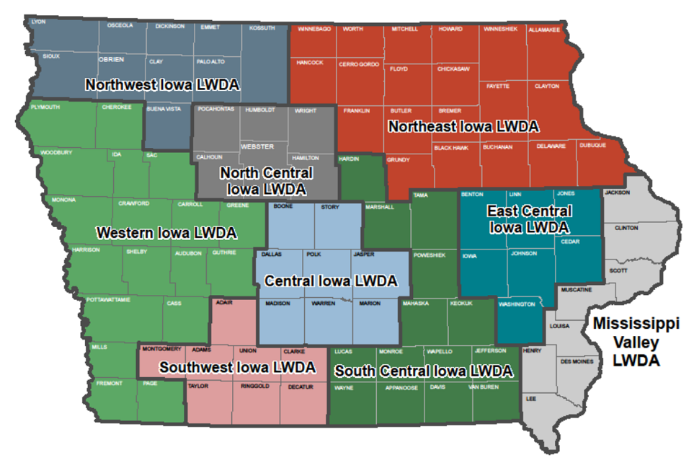
Iowa’s Local Workforce Development Areas

Slide 11
What is WIOA?
Workforce Innovation & Opportunity Act

Slide 12

Workforce Innovation and Opportunity Act (WIOA)
Signed into law with broad, bi-partisan support on July 22, 2014
First major workforce development legislation since the Workforce Investment Act of 1998
Outlines the vision, goals, objectives, and requirements for how the public workforce system is structured and operates

Slide 13
WIOA Titles
WIOA
Title I
Title II
Title III
Title IV
Adult, Dislocated Worker, and Youth
Adult Education
and Literacy
Wagner Peyser Employment Services
Vocational Rehabilitation Services

Slide 14
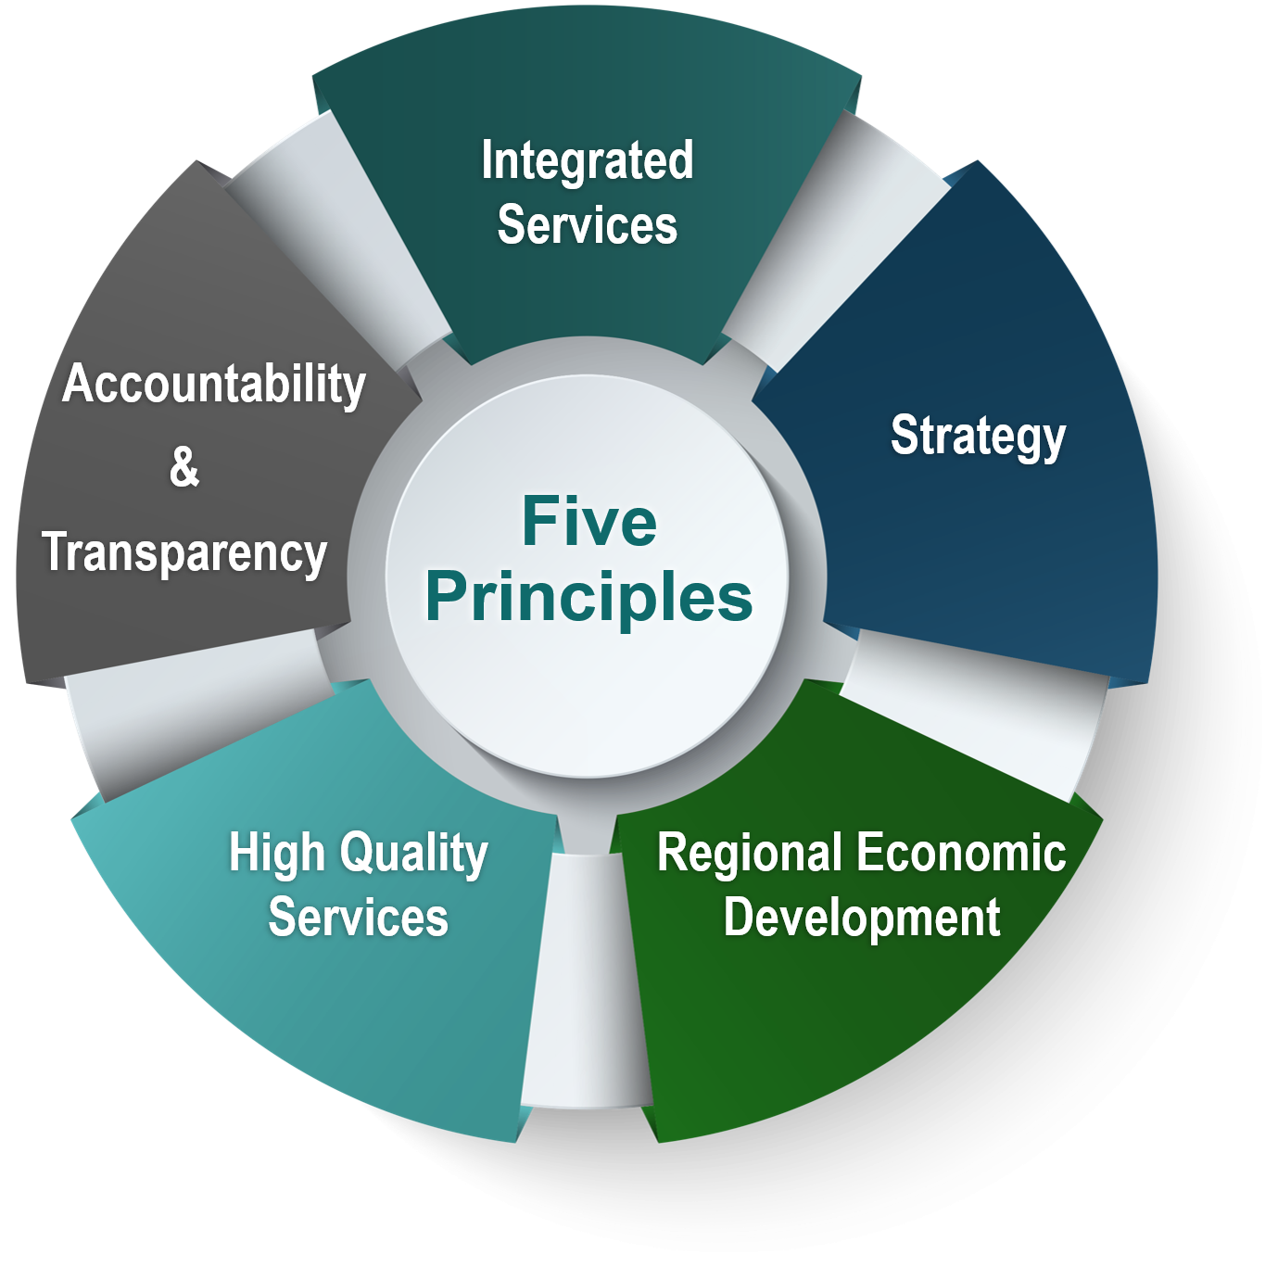
WIOA: Five principles
Integrated Service Delivery
Focus on Strategy
Regional Economic Development
High Quality Services
Accountability & Transparency

Slide 15

WIOA “Hallmarks of Excellence”

Slide 16

IowaWORKS

Slide 17

The Iowa Works System
Is Iowa’s network of federally-funded programs focused on employment and training services
Includes a broad range of services for unemployed, under-employed and youth, such as:
  Case management
  Assessment
  Career exploration
  Soft skills prep
  Resume writing, job search techniques and interviewing
  Direct access or referral to supportive services such as transportation, housing support, daycare, substance abuse treatment, etc.
  Training
  Job search and placement
Includes services for businesses, such as:
  Job postings
  Referrals
  Customized training
  On-the-job training
  Incumbent worker training

Slide 18
Governance and Oversight Framework
US Department of Labor
Oversight
State Governor
Funding
Appointment
Consultation
Appointment
Funding Oversight
State Workforce Development Board
State Workforce Agency
Consultation
Vision Oversight
Guidance
Compliance
Funding
Consultation
Chief Elected Officials
Funding
Appointment
Partnership
Approvals
Joint
Oversight
IowaWORKS
Local Workforce Development Board

Slide 19

US Department of Labor
USDOL, Employment and Training Administration (ETA)
  Grants funding to the states and territories
  Conducts monitoring and oversight
  Provides technical assistance and support
National Office in Washington DC with six regional offices
  Iowa is under Region 5 which is the Chicago office

Slide 20

Governor
Receives funding from USDOL
Designates State Workforce Development Board
Designates State Workforce Agency

Slide 21
State Workforce Development Board
Responsibilities
Membership
Set statewide vision for workforce development system
Ensure continuous improvement of the system
Engage businesses and other stakeholders to achieve the WIOA vision
Business
  51% minimum representation
Labor organizations and workforce representatives
State agencies in workforce system
Elected officials: state and local
Community based organizations

Slide 22
State Workforce Agency
Iowa Workforce Development or IWD
Oversees administrative functions of the state and local system
Issues policy to the system
Convenes partners
Monitors the system for compliance
Executes contracts with local workforce development areas (LWDA) for WIOA funding

Slide 23
Chief Elected Officials/ Chief Lead Elected Official
County Board of Supervisors’ Chair or designee from within the Board of Supervisors
One Chief Elected Official (CEO) per county
One Chief Lead Elected Official (CLEO) per LWDA
Purpose is to set the foundation for the Local Workforce Development Board (LWDB) to be strategic
Has liability for WIOA Title I funds in their LWDA

Slide 24
Local Workforce Development Board
Membership requirements are similar to SWDB
  51% minimum requirement for business representation
Set the vision for the local workforce system and oversees its implementation and operation
Develop strategic plans
Set priorities for funding
Convene partnerships between businesses and community stakeholders
Make data driven decisions
Establish sector strategies driven by in-demand occupations and industries

Slide 25
Any Questions? (2)

Slide 26
Key Tasks of Chief Elected Officials

Slide 27
Categories of Tasks
Appoint/ Select
Review and Approve
High Level Oversight
Strategic Planning

Slide 28
Key CEO Tasks- not an exhaustive list
Select a Chief Lead Elected Official
Appointing Local Workforce Development Board members
Appointing a Fiscal Agent
Approve the Local Workforce Development Board’s selection of One Stop Operator
Approve Local Workforce Development Board budget
Enter into a CEO Shared Liability Agreement
Provide oversight to the one stop delivery system and WIOA title I programs (in collaboration with the Local Workforce Development Board

Slide 29

1. Select a Chief Lead Elected Official
Selected from among the CEOs
Represents the CEOs and makes decisions on their behalf
Designated signatory
    The CLEO position is like the Chairperson of a board

Slide 30
2. Appoint Local Workforce Development Board
The Local Workforce Development Board is a separate entity from the group of Chief Elected Officials- separate membership, separate tasks.
CEOs appoint the Local Workforce Development
  CEOs decide the size of the board
The Workforce Innovation & Opportunity Act provides clear guidelines for who can serve on a local workforce board.
CEO recorded module 3 provides a detailed overview of Local Workforce Development Board Membership categories, criteria and other pertinent information.

Slide 31
3. Appoint a Fiscal Agent
The CLEO (on behalf of all CEOs) may designate a fiscal agent
  Should a Fiscal Agent not be designated, the CLEO’s unit of government shall fulfill the role
Receive funds
Ensure sustained fiscal integrity
Respond to audit findings
Maintain proper and adequate records
Prepare financial reports
Procure contracts and other agreements
Conduct financial monitoring of service providers
Ensure independent audit of all employment & training programs

Slide 32

4. Approve Selection of One Stop Operator
Primary responsibility of One Stop Operator is to coordinate the service delivery of required one stop partners and service providers
Optional roles:
  Primary service provider in the center
  Provide some of the services in the center
  Coordinate service providers across the system
Must be competitively procured every four years

Slide 33
5. Approve Local Workforce Development Board Budget
The LWDB must develop a budget based on needs of the workforce system customers (business and individual) in the local area.
Budget must:
  Be consistent with the Local Workforce Development Plan which is the document that outlines what workforce services will be provided and how.
  Include Infrastructure Funding Agreements for the local system.
    Outlines how one stop partners will share costs within the local system.

Slide 34
Financial Liability
The Chief Elected Officials in a local workforce development area are liable for any misuse of the WIOA grant funds allocated to the local area.
The designation of a Fiscal Agent does not relieve the CEOs of this responsibility nor does the designation of a Chief Lead Elected Official.
CEOs must determine the method for apportioning liability and document it in a written agreement.
Refer to CEO Training Module #2 for more information on the Shared Liability Agreement.

Slide 35
6. Enter into CEO Shared Liability Agreement
Purpose: To document how CEOs work together to accomplish the numerous tasks ascribed to them under the Workforce Innovation & Opportunity Act including how CEOs will share liability for funds
Required by federal law when the local workforce development area is multi-jurisdictional
CEOs are grouped together based on local workforce development area
Known in Iowa as a 28e Agreement

Slide 36
7. Provide Oversight to the One Stop System and WIOA Title I programs
Done in partnership with the Local Workforce Development Board
Joint oversight between the two groups ensures the system is accomplishing the vision set forth by WIOA and its corresponding regulations.
Oversight is done by:
  Ensuring compliance with requirements to establish: (not an exhaustive list)
    Local Plan
    Local Memorandum of Understanding and Infrastructure Funding Agreements
    Local Budget
    Effective practices for selection and monitoring of providers- One Stop Operator, Adult/ Dislocated Worker, and Youth providers

Slide 37
Any Questions? (3)

Slide 38
CEO Tools and Resources

Slide 39

List of Resources to be covered
CEO Orientation & Training Guide
  CEO recorded training modules
Iowa State Workforce Development Board
  Roster
  Meeting schedule
  Members
State Plan
Iowa Workforce Development (IWD)
  Contact person
  E-policy site
  Contracts

Slide 40
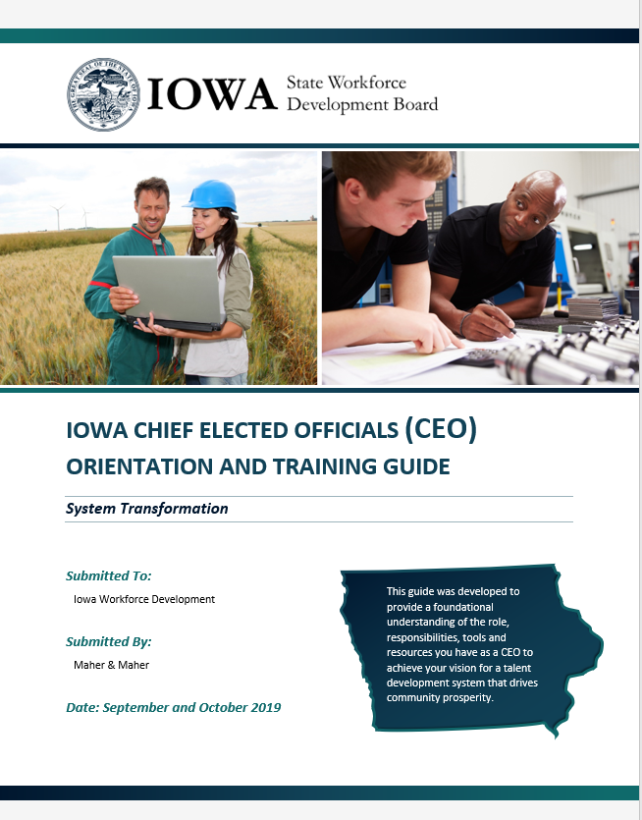
CEO Orientation and Training Guide
Link to Guide and Recorded modules

Slide 41

Iowa’s State Workforce Development Board
SWDB website

Slide 42
State Plan
WIOA requires states to submit a four-year plan to the U.S. Department of Labor that outlines a four-year strategy for the state workforce development system.
SWDB ensures the State Plan reflects its vision, priorities and strategies for workforce development in the state.
States must have approved plans in place to received federal funding.
Planning is coordinated across the six core programs to reflect integrated priorities/strategies:
  WIOA Titles I, II and III (Adult, Dislocated Worker, Youth and Wagner-Peyser)
  Adult Education
  Vocational Rehabilitation
State Plan link

Slide 43

Iowa Workforce Development
Link to ePolicy site
Oversees administrative functions of the state and local workforce system
  Issues policy to the system
  Convenes partners
  Monitors the system for compliance
  Executes contracts with Local Workforce Development Areas

Slide 44
IWD Contract with Fiscal Agent: An Overview
IWD holds a contract with the Fiscal Agent for your local area
  Contract is signed by IWD, CLEO, and Executive Official of Fiscal Agent
Fiscal Agent receives the funding from IWD and receives direction from LWDB on how to spend the funds
  Fiscal Agent must track funding and report to IWD and LWDB on the funding.
  IWD monitors the Fiscal Agent for compliance with law, regulations, and policy.

Slide 45
Next Steps in Onboarding
The Local Workforce Development Board will provide the next phase of your Onboarding and Orientation process.
From the Local Board, you should receive the following:
  CEO roster and contact information
  Current Shared Liability Agreement
  Current Fiscal Agent Agreement
  LWDB Information
    Member roster
    Budget
    Bylaws
    Staff Contact Information
    Latest monitoring report, if applicable
    Existing local policies
    Any other documents to help you understand your role

Slide 46
Any Questions? (4)

Slide 47
Thank You!

