Slide 1
CEO Office Hours

Slide 2
Today’s Presenter
Michelle McNertney
  Michelle.mcnertney@iwd.iowa.gov

Slide 3
Purpose of Office Hours
To provide an opportunity for Chief Elected Officials (CEOs) to
  Ask questions and seek clarification regarding their tasks within the Iowa workforce system transformation
  Engage in dialogue with other CEOs and Iowa Workforce Development
To provide an opportunity for Iowa Workforce Development to
  Provide guidance or explanation on policies

Slide 4
Objectives of Office Hours
Provide updated guidance on funding for One-Stop Operators
Review Transition Plans for outgoing service providers
Review the process for extending contracts
Answer questions regarding CEO Transformation key tasks

Slide 5
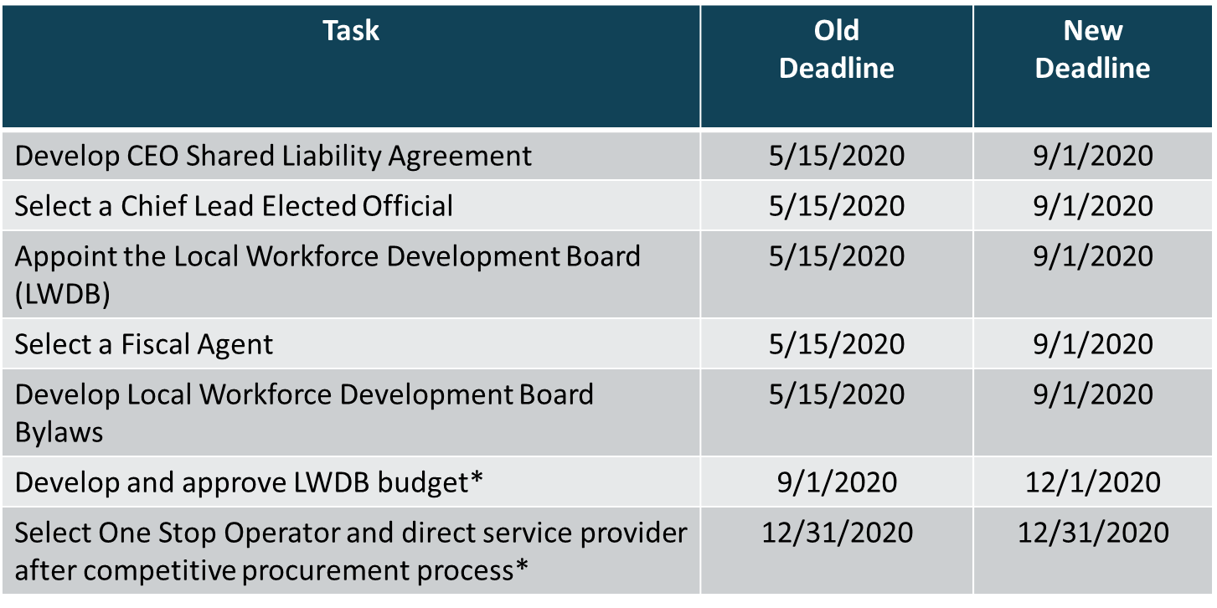
CEO Key Deliverables/ Revised Timeline

Slide 6
One Stop Operator Updates

Slide 7
Four Selected Roles in the Local Workforce System Structure
Fiscal agent
Board staff
One Stop Operator
Service providers

Slide 8
Funding for Local Workforce System Roles

Slide 9
Outgoing Service Provider Transition Guidance

Slide 10
Outgoing Service Providers
Existing contracts being extended include the service providers acting as the fiscal agent for the Local Area
These roles will continue through 12/31/20 where contracts are extended
Appointment of Fiscal Agents by 9/1/20
Will be overlap of “fiscal agents” in these local areas until 12/31/20

Slide 11
CLEO Meetings Regarding Budget

Slide 12
Contract Discussions per Local Workforce Development Area
Will schedule meetings with each Local Area next week
  CLEOs and LWDB Chairs
Contract extensions or appointments are through 12/31/20
CLEOs need to decide how much of the PY20 funds will be put into the contracts or extensions

Slide 13
Next Steps
Fiscal Agent Agreement Template
Fiscal Agent Training
Local Board Training

Slide 14
Questions?

Slide 15
Contact
      WIOAgovernance@iwd.iowa.gov
      Michelle.mcnertney@iwd.iowa.gov
      Linda.rouse@iwd.iowa.gov
      Michael.witt@iwd.iowa.gov

Slide 16
Next Office Hours
Friday, June 12
12:00 pm

Slide 17
Thank You!

