Slide 1
CEO Office Hours

Slide 2
Today’s Presenter
Michelle McNertney
  Michelle.mcnertney@iwd.iowa.gov

Slide 3
Purpose of Office Hours
To provide an opportunity for Chief Elected Officials (CEOs) to
  Ask questions and seek clarification regarding their tasks within the Iowa workforce system transformation
  Engage in dialogue with other CEOs and Iowa Workforce Development
To provide an opportunity for Iowa Workforce Development to
  Provide guidance or explanation on policies

Slide 4
Objectives of Office Hours
Update on LWDB Websites
Review Field Memo 20-09 MOUs
Overview of Disaster Recovery NDWG for Derecho

Slide 5
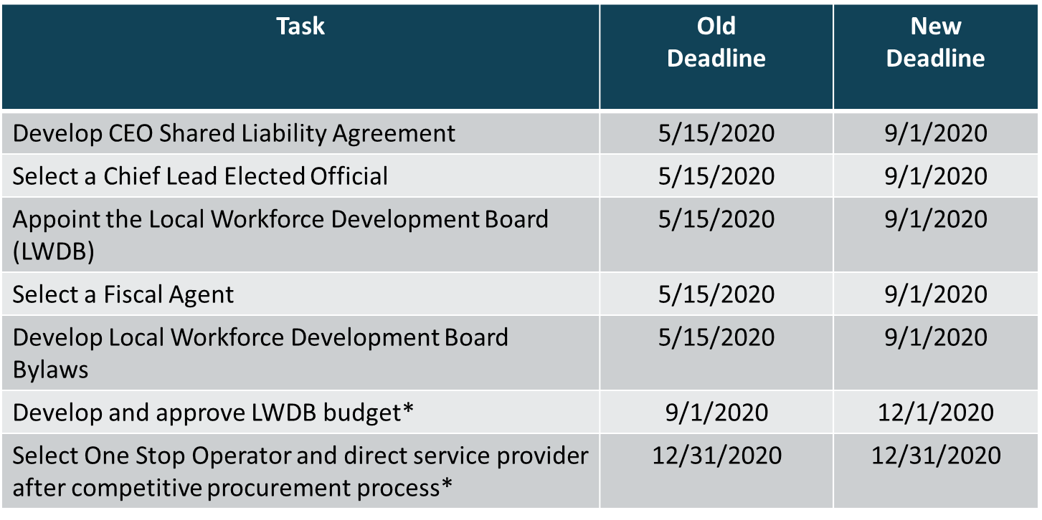
CEO Key Deliverables/ Revised Timeline

Slide 6
LWDB Websites
Training was provided on 8/27/20 to LWDB Staff
New sites will go live on 9/15/20
LWDB/staff are responsible to maintain information on site
www.iowawdb.gov

Slide 7
Field Memo 20-09: MOUs
Issued 9/2/2020
Requires temporary MOU to be in place by 10/31/2020
Several options depending on each LWDA situation
Used to ensure required partners are participating in the One-Stop System

Slide 8
Disaster Recovery NDWG for Derecho
Informational call today at 1:30 pm
  (866) 685-1580 Conference code: 4556611386
Provides funding for Temporary Jobs (up to 12 months) to aid in Disaster Clean-up
Available in all Counties declared for Public Assistance (Categories A-G) under the FEMA Disaster Declaration
  Benton Boone Cedar Clinton Dallas
  Jasper Johnson Jones Linn Marshall
  Muscatine Polk Poweshiek Scott Story
  Tama

Slide 9
Questions?

Slide 10
Contact
      WIOAgovernance@iwd.iowa.gov
      Michelle.mcnertney@iwd.iowa.gov
      Linda.rouse@iwd.iowa.gov
      Michael.witt@iwd.iowa.gov

Slide 11
Next Office Hours
Friday, September 18
12:00 pm

Slide 12
Thank You!

