Slide 1
CEO Office Hours

Slide 2
Today’s Presenter
Michelle McNertney
michelle.mcnertney@iwd.iowa.gov

Slide 3
Purpose of Office Hours
To provide an opportunity for Chief Elected Officials (CEOs) to
Ask questions and seek clarification regarding their tasks within the Iowa workforce system transformation
Engage in dialogue with other CEOs and Iowa Workforce Development
To provide an opportunity for Iowa Workforce Development to
Provide guidance or explanation on policies

Slide 4
Objectives of Office Hours
Title I Service Provider RFP Templates
FY21 Funding Allotments

Slide 5
CEO Key Deliverables/ Revised Timeline

Slide 6
Title I Service Provider RFP

Slide 7
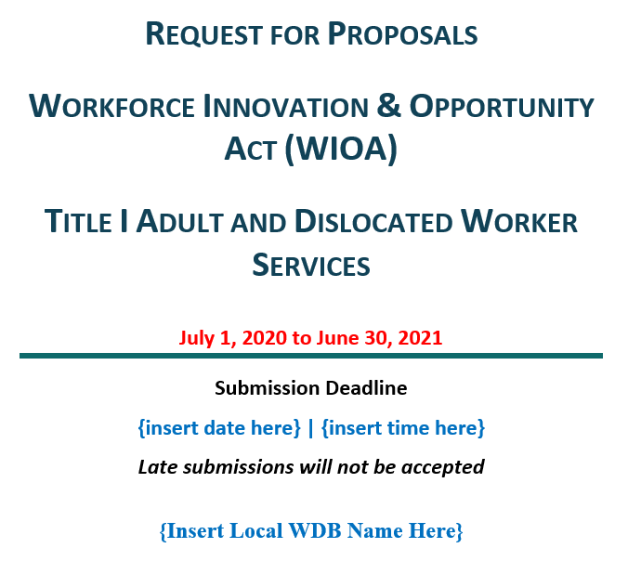
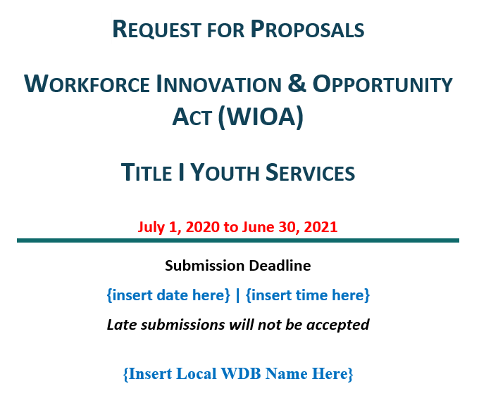
Title I Service Provider RFP Templates

Slide 8
Things to know about the RFP
All areas required to have competitively procured service providers in place by 1/1/2021
This should be a joint task between the CEOs and the LWDB.
IWD Policy 1.4.8.1 requires that service providers for adult, dislocated worker and youth services be procured
You are not required to use this template
It was written generically and each LWDA will need to customize it. The sections which require customization are in red. (also remove SWDB logo and add yours)
Best Practices are highlighted in text boxes throughout the document
Info in RFP will dictate the contract with the selected Service Provider

Slide 9
Sections of the RFP
Background and General Information
Procurement Process & Requirements
Statement of Work
Proposal Guidelines
Terms and Conditions
Appendices

Slide 10
Section I- Background and General Information
The specific LWDB (local workforce development board) and LWDA (local workforce development) must be noted.
Start and stop dates of the work to be done.
Identify who is the contact person for the RFP
This will generally be the Executive Director of the LWDB. If a LWDB does not have a staff person, one person will need to be agreed upon.
IWD can provide the estimated amount funding for the upcoming year. The amount available to a contractor for services must be noted in the RFP

Slide 11
Section II- Procurement Process & Requirements
This is where you outline what is expected of bidders during the procurement process.
Things presented here are optional; however, it is a good idea to think through all of these issues
Bidders’ Conference- a common way to answer questions during a bid process

Slide 12
Section III- Statement of Work
This section outlines the bidders’ approach to providing adult, dislocated worker, and youth services
Identify location of IowaWORKS offices where services will be delivered
Covers topics such as
Integrated services- how they’ll work within the already established system
Outreach and Branding
Enrollment
Adult/DW/Youth Program Design
Career Pathways
Performance Indicators and Goals/Poor Performance
Staff Training and Development
Data Management and Reporting
Contract Oversight and Evaluation

Slide 13
Subcontractors
CEOs and the LWDB will decide if the service provider can have a subcontractor
Things to consider
An entity providing a bid to be a service provider should identify subcontractors within their proposal for services.

Slide 14
Section IV- Proposal Guidelines
Proposal requirements- narrative and budget
This is what the bidders will use to develop their proposal. It tells the questions to be answered and the topics to cover.
Budget and Budget Narrative
Review and Selection Process
Outlines how proposals will be evaluated
Provides a timeline for entire process
Provisions- additional information and disclaimers regarding the process

Slide 15
Section V- Terms and Conditions
Standard terms and conditions for a bid process
Requires liability insurance

Slide 16
Appendices
Appendix A- Cover sheet to be used by bidders
Appendix B- Budget Sheets
Appendix C- Assurances and Certifications
Appendix D- Evaluation Criteria
Appendix E-Estimates of Fixed Costs per Center (not included in template)
Information provided by the LWDB to be used by the bidder to complete budget pages
Consider adding to your RFP

Slide 17
Appendix B- Budget Sheets
Budget Summary- this is a roll up chart of all the budget detail charts
Budget Detail
Salary Detail
Personnel Benefit Detail
Mileage Detail
Travel Detail
Direct Cost Detail
Profit Cost Detail
Participant Costs- Training
Participant Costs- Support
Participant Costs- Work Experience
Budget Summary, Detail and Narrative Instructions

Slide 18
Direct Cost Detail
Line Item | Amount Requested
Materials & Supplies (Non-Training Related) | $
Telephone | $
Postage | $
Rent | $
Utilities | $
Maintenance | $
Bond | $
Advertising | $
Audit | $
Other (Specify) | $
Other (Specify) | $
Total Direct Costs | $
IWD can work with you to provide estimates on these costs per center
Based on actual costs from current service providers

Slide 19
Appendix C- Assurances and Certifications
Signatory for bidding organization must sign attesting to these conditions.

Slide 20
Appendix D- Evaluation Criteria
Evaluation of each proposal is based on the following
Ability of the program to help the {insert name here} meet performance goals
Reasonableness and affordability of the unit price
How well the program will collaborate with other organizations in the community
Organizational capacity and experience in providing programs for Adult and Dislocated Workers

Slide 21
FY21 Funding Allotments

Slide 22
FY21 Funding Allotment Information
FY21 (9 month money) Adult and Dislocated Worker funds available around 10/1/2020
IWD has to receive $ from DOL before can be contracted to Local Areas (have not received to date)
FY21 funds cannot be used for expenditures accrued prior to 10/1/2020

Slide 23
Next Steps

Slide 24
Next Steps
LWDB Training
Local Area Performance Negotiations with LWDB
One-Stop Operator Procurement
Local Plans

Slide 25
Questions?

Slide 26
Contact
WIOAgovernance@iwd.iowa.gov
Michelle.mcnertney@iwd.iowa.gov
Linda.rouse@iwd.iowa.gov
Michael.witt@iwd.iowa.gov

Slide 27
Next Office Hours
Friday, September 18
12:00 pm

Slide 28
Thank You!

