Slide 1
CEO Office Hours

Slide 2
Today’s Presenter
Michelle McNertney
  michelle.mcnertney@iwd.iowa.gov

Slide 3
Purpose of Office Hours
To provide an opportunity for Chief Elected Officials (CEOs) to
  Ask questions and seek clarification regarding their tasks within the Iowa workforce system transformation
  Engage in dialogue with other CEOs and Iowa Workforce Development
To provide an opportunity for Iowa Workforce Development to
  Provide guidance or explanation on policies

Slide 4
Objectives of Office Hours
Ticket to Work Funding Training
PY20 WIOA Title I Monitoring Information
Update on Funding
  Master Agreements
  Modifications for Funding
  FY21 Adult/Dislocated Worker Funding

Slide 5
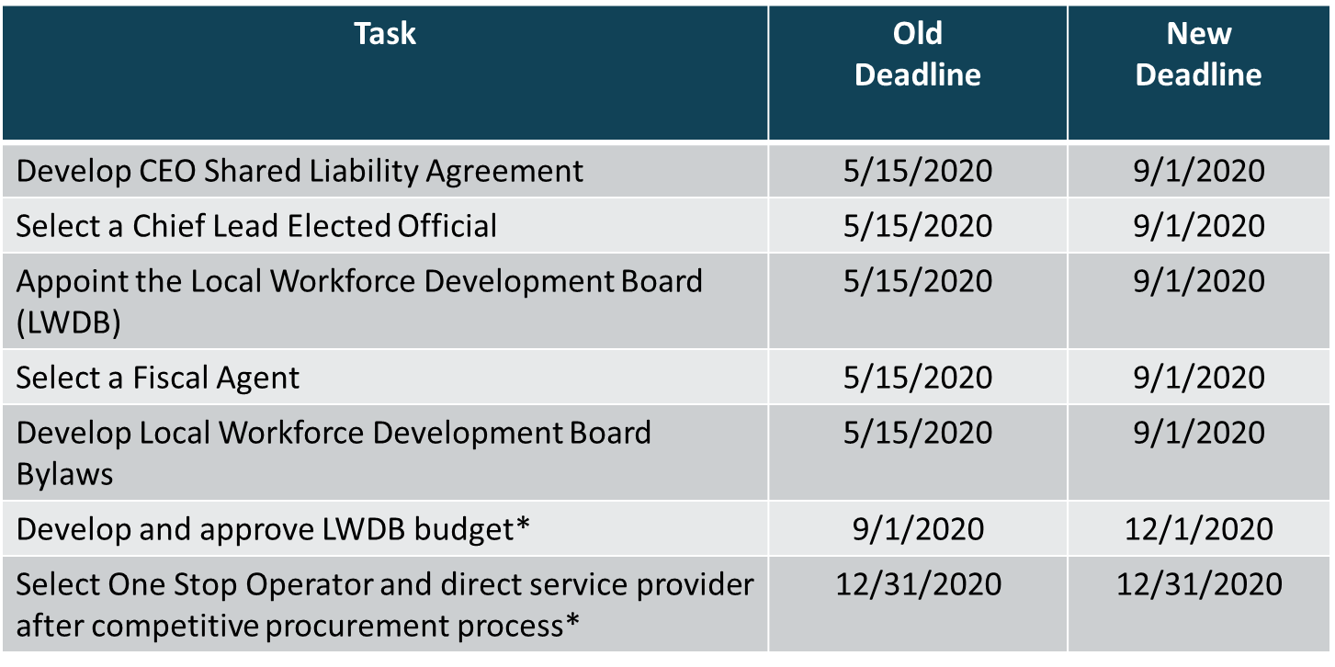
CEO Key Deliverables/ Revised Timeline

Slide 6
Ticket to Work Program
EN Responsibilities

Slide 7
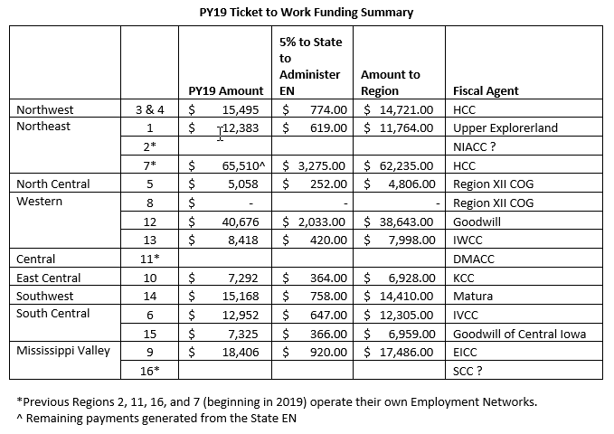

Slide 8
WHAT IS THE TICKET TO
WORK PROGRAM?
The Ticket to Work (Ticket) program:
Is Social Security’s national employment program
Supports career development for people with disabilities who want to work
Is for Social Security disability beneficiaries ages 18 through 64
Is free and voluntary
Individuals or Ticket Holders earn incentive payments by meeting certain milestones
Incentive payments are received by Employment Networks (ENs)
To used for the “employability of persons with a disability”.

Slide 9
Employment Networks (EN)
Tickets can be assigned to “Employment Networks”
Iowa Workforce Development (IWD) and other partners are an “Employment Network”
Employment Networks are responsible for:
  Serving the Ticket Holders
  Creating SSA approved plans (including routine contacts and documentation)
  Responding to SSA required monitoring and file reviews
  Annual Administrative responsibilities

Slide 10
Under the Current Structure
IWD functions as the EN for most of the LWDAs
Through the AJCs the customers are served and Case Managed
IWD is responsible for all Administrative duties:
  Responses to Monitoring
  Reporting
  Ensuring staff maintain Suitability
  Resolving any questions by SSA
Local areas receive 95% of incentive dollars

Slide 11
Questions?

Slide 12
Brian S. Dennis, M.S., CRC
Workforce Program Coordinator - Disability Services
Phone: 515-725-3666
Brian.Dennis@iwd.iowa.gov

Slide 13
PY20 WIOA Title I Monitoring

Slide 14
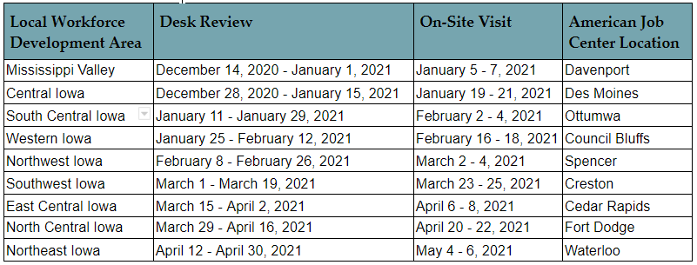
PY20 Monitoring Schedule

Slide 15
PY20 Monitoring Timeline and Steps
Activity | Roles and Responsibilities
Notification | Iowa Workforce Development (IWD) will issue a written notification of intent to monitor, at a minimum of 15 days prior to the commencement of each review.
Desk Review | IWD will conduct remote desk reviews as scheduled
On-Site Visit | IWD will visit each local workforce development area as scheduled The visit will consist of three components: Entrance Conference - The entrance conference will open the monitoring on Tuesday. It will be held with the Local Workforce Development Board (WDB) director, in accordance with Local Board Staff, and any other Local WDB members or program staff the Local WDB director wishes to invite. Monitoring Exit Conference - The exit conference will be held on Thursday at the completion of monitoring. It will be held with the Local Workforce Development Board (WDB) director, in accordance with Local Board Staff, and any other Local WDB members or program staff the Local WDB director wishes to invite.
Monitoring Report | IWD will issue a monitoring report to the Local Workforce Development Board within 30 business days from the conclusion of the monitoring review.
Corrective Action Plan | The Local WDB will submit a corrective action plan and supporting documentation electronically to iwd.WIOA@iwd.iowa.gov regarding the identified findings within 20 business days of receipt of the monitoring report.
Resolution | IWD will review the corrective action plan and make a determination on the acceptability of the plan within 20 business days of receiving the corrective action plan.

Slide 16
Title I Funding Information

Slide 17
PY20/FY21 Funding Update
All Master Agreements with Fiscal Agents have been sent out
The Notice of Award (NOA) from the National Office for FY21 Title I Adult/DW funds was received 10/29/20
IWD will prepare Modifications as follows:
  Existing master agreements from IWD to SPs through 12/31/20 – based on amounts provided by CEOs
  All remaining funds for PY20/FY21 added to the master agreements with Fiscal Agents
  Sent out week of 11/2

Slide 18
Next Steps

Slide 19
Next Steps
Local Area Performance Negotiations
Local Plan Guidance

Slide 20
Questions?

Slide 21
Contact
      WIOAgovernance@iwd.iowa.gov
      michelle.mcnertney@iwd.iowa.gov
      linda.rouse@iwd.iowa.gov
      michael.witt@iwd.iowa.gov

Slide 22
Next Office Hours
Friday, November 13
12:00 pm

Slide 23
Thank You!

