Slide 1
LWDA Leadership Office Hours

Slide 2
Today’s Presenter
Michelle McNertney
  michelle.mcnertney@iwd.iowa.gov

Slide 3
Purpose of Office Hours
To provide an opportunity for LWDA Leadership (CEOs, LWDB Directors, Staff to the Board) to
  Ask questions and seek clarification regarding their tasks within the Iowa workforce system transformation
  Engage in dialogue with other LWDA Leadership and Iowa Workforce Development
To provide an opportunity for Iowa Workforce Development to
  Provide guidance or explanation on policies

Slide 4
Objectives of Office Hours
Local Area Performance Negotiations Update

Slide 5
LWDA Leadership Key Deliverables/ Revised Timeline - Updated
Task | Deadline | Responsible Party
Select direct service provider using competitive procurement process | 12/31/2020 | LWDB
Select One-Stop Operator using competitive procurement process | ?? | LWDB
Complete Local Area Performance Negotiations | 2/28/2021 | LWDB
Complete Local Plan | 4/15/2021 | LWDB*
Develop and approve LWDB budget for PY21 (7/1/21 – 6/30/22) | 5/15/2021 | LWDB*
Execute contract extensions/modifications for Title I Service Providers for 7/1/2021 or complete new RFP for Title I Service Provider effective 7/1/2021 | 6/30/2021 | LWDB*
*Requires final approval from CLEO

Slide 6
Local Area Performance Negotiations

Slide 7
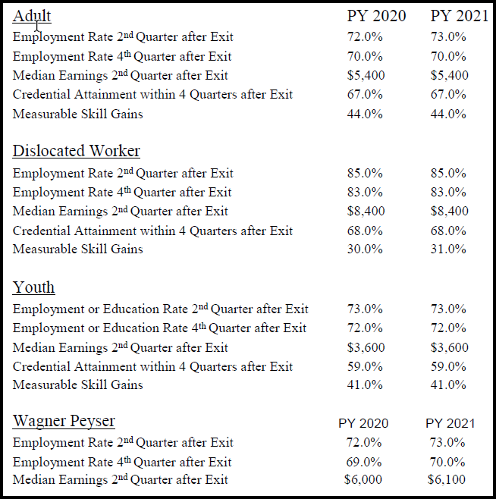
PY20 / PY21 State Negotiated Rates

Slide 8
Process - Local Area Performance Negotiations
Statistical Adjustment Model (SAM) developed for each LWDA and provided to each LWDB
LWDB uses SAM to propose levels of performance for each measure
  5 measures for Adult
  5 measures for Dislocated Worker
  5 measures for Youth
  3 measures for Wagner Peyser
Proposed levels of performance submitted to IWD prior to Negotiations
LWDB and IWD Negotiate
IWD issues correspondence with agreed upon performance rates

Slide 9
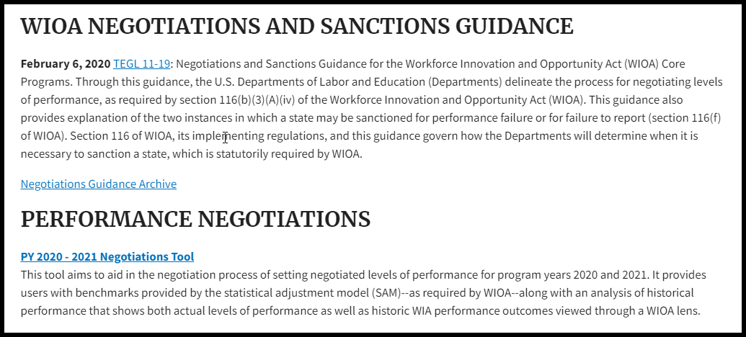
U.S. DOL WIOA Negotiations website
https://www.dol.gov/agencies/eta/performance/goals/negotiated-performance-levels
State SAM

Slide 10
Timeline - Local Area Performance Negotiations
1/4/2021 - SAMs sent to LWDBs
1/8/2021 - Training for SAM/Negotiations at Office Hours call
2/1/2021 - Deadline for LWDBs to submit proposed goals to IWD
2/15/2021 - Negotiations Completed

Slide 11
Next Steps

Slide 12
Next Steps
Local Plan Guidance » December 1st

Slide 13
Questions?

Slide 14
Contact
      WIOAgovernance@iwd.iowa.gov
      michelle.mcnertney@iwd.iowa.gov
      linda.rouse@iwd.iowa.gov
      michael.witt@iwd.iowa.gov

Slide 15
Next Office Hours
Friday, December 11th
12:00 pm

Slide 16
Thank You!

