Slide 1
WIOA Office Hours
January 20, 2023
Notes:
Michelle

Slide 2
Today’s Objectives
Answer questions related to
  Local grant recipient identification and implementation
  U.S. DOL guidance on local refusal of WIOA funds
  Local area realignment
Provide opportunity for questions and discussion
Notes:
Lori

Slide 3
Today’s Agenda
Welcome and Introductions
Local Grant Recipient/Subrecipient Agreement Review
Refusal of Funds by CEOs
Local Area Realignment Questions
Notes:
Lori

Slide 4
Comments from U.S. DOL
Stacy Okeefe
  Federal Project Officer for Iowa

Slide 5
Identifying a Local Grant Recipient
Notes:
Lori, slides 7-17

Slide 6
Local Grant Recipient
Definition
Who is this in Iowa?
Not defined in Uniform Guidance or WIOA but is the term WIOA uses to refer to the local area subrecipient.
By default, this the CLEO’s unit of government though the CLEO can designate an alternate entity to serve as the local grant recipient.

Slide 7
Subrecipient
Definition
Who is this in Iowa?
An entity, usually, but not limited to non-Federal entities, that receives a subaward from a pass-through entity to carry out part of a Federal award.
Does not include an individual that is a beneficiary of such award.
May also be a recipient of other Federal awards directly from a Federal awarding agency.
Local grant recipient is a subrecipient of IWD.
One-stop operators and service providers are subrecipients of the local grant recipient.

Slide 8
Three Options
A. The CLEO’s unit of government is the local grant recipient.
B. The CLEO designates an alternate entity to serve as the local grant recipient.
C. The CLEO’s unit of government is the local grant recipient, and the CLEO designates an entity to be the Fiscal Agent.

Slide 9
In Context for Iowa
IWD is the grant recipient and serves as the pass-through entity when it provides a subaward to the local grant recipient thereby creating a subrecipient relationship with the local grant recipient.

Slide 10
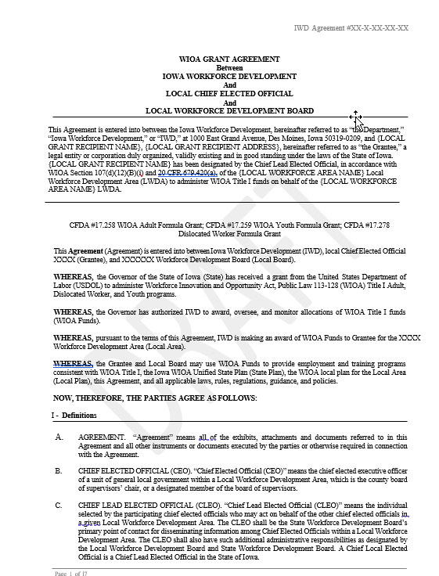
WIOA Subrecipient Agreement

Slide 11
What questions do you have?

Slide 12
Refusal of WIOA Funds by CEOs
Notes:
Brittany – slides 39 - 51

Slide 13
Guidance from U.S. DOL
Email sent to CLEOs, LWDB Chairs, and LWDB Staff on 1/17/23 detailing guidance from U.S. DOL on refusal of WIOA Title I funds
CEOs can refuse funds and choose to no longer operate as a local area
All CEOs in a local area must agree to refuse funds

Slide 14
If CEOs Decide to Refuse Funds
All CEOs from the Local Area and the LWDB Chair must sign a letter addressed to Director Townsend stating their intent to refuse the funds and no longer operate as a local area
This removes fiscal liability from the CEOs
Effective 7/1/23
LWDB is decertified and disbanded
CEOs no longer have input in the local workforce system
Becomes State (IWD) responsibility to ensure continuity of service

Slide 15
What questions do you have?

Slide 16
Local Area Realignment
Notes:
Brittany – slides 39 - 51

Slide 17
What questions do you have?

Slide 18
Wrap-Up and Next Steps

Slide 19
Next Steps
Identify and designate Local Grant Recipient
  Finalize by 2/28/23 or soon after
Inform IWD of Intent to Realign Local Areas and send letter to SWDB requesting realignment
  Next SWDB meeting on 3/8/23
Inform IWD of Intent to Refuse WIOA Title I Funds
Communication is Key!

Slide 20
Contact Information
Michelle McNertney
  Division Administrator- Workforce Services
    Iowa Workforce Development
      Michelle.mcnertney@iwd.iowa.gov
        515.242.0408
Wendy Greenman
  Bureau Chief- Workforce Services
    Iowa Workforce Development
      Wendy.greenman@iwd.iowa.gov
        641-278-6618
Notes:
Michelle

Slide 21
Thank You!

