Slide 1
Infrastructure Funding Agreement
Technical Assistance Session
Tuesday, August 22, 2023

Slide 2
Welcome!
Michelle McNertney
Division Administrator
Workforce Services
Iowa Workforce Development
michelle.mcnertney@iwd.iowa.gov
Wendy Greenman
Bureau Chief WIOA Title I | TAA
Iowa Workforce Development
wendy.greenman@iwd.iowa.gov
Kyle Clabby-Kane
Bureau Chief WIOA Title II | Title III
Iowa Workforce Development
kyle.clabby@iwd.iowa.gov
Victor Kennedy
Chief Financial Officer
Iowa Workforce Development
victor.kennedy@iwd.iowa.gov
Brian Dennis
Interim Administrator
Iowa Vocational Rehabilitation Services
brian.dennis@iowa.gov
Brandy McOmber
Program Manager
Iowa Vocational Rehabilitation Services
brandy.mcomber@iowa.gov
Mary Jackson
Transition Services Program Manager
Iowa Vocational Rehabilitation Services
mary.jackson@iowa.gov
Keri Osterhaus
Vocational Rehabilitation Program Administrator
Iowa Department for the Blind
keri.osterhaus@blind.state.ia.us

Slide 3
Agenda
Resources
Glossary Terms
IFA Responsibility
Identifying Partners and Parties to the Agreement
IFA Cost Pool, Cost Items, Allocation Base
Timeline
Office Hours
Questions and Discussion

Slide 4
Resources
State Workforce Development Board Website: https://www.iowawdb.gov/
  WIOA MOU/IFA Template Guidance
  One-Stop Operating Budget Workbook
  MOU Template
  Memorandum of Understanding Policy 1.4.10
Iowa ePolicy Website: https://epolicy.iwd.iowa.gov/Policy/Home
  Memorandum of Understanding Policy 1.4.10
  Technical Assistance Resources
    WIOA MOU/IFA Template Guidance
    One-Stop Operating Budget Workbook
    MOU Template

Slide 5
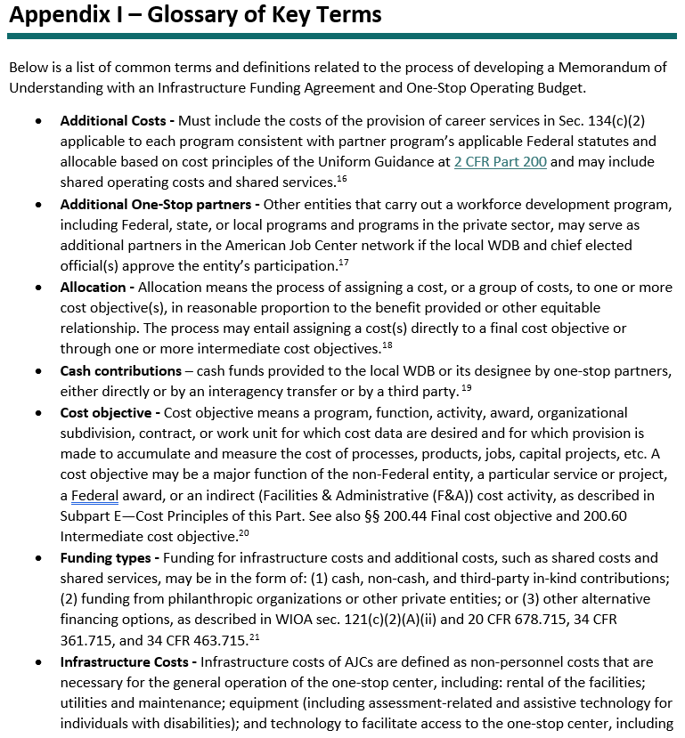
Glossary Terms
WIOA MOU/IFA Template Guidance
  Page 49: Appendix I – Glossary of Key Terms

Slide 6
IFA Responsibility
WIOA requires the Local WDB, with agreement from the CLEO, to develop and enter into a MOU (which includes the IFA), between the Local WDB and the One-Stop Partners concerning the operation of the one-stop delivery system in a LWDA.
    The Local WDB has the key responsibility for negotiating and developing the MOU (including IFA components).
LWDB
convener/ultimate responsibility
Local Partners
party to MOU
Executed
MOU

Slide 7
Identifying Partners and Parties to the Agreement

Slide 8
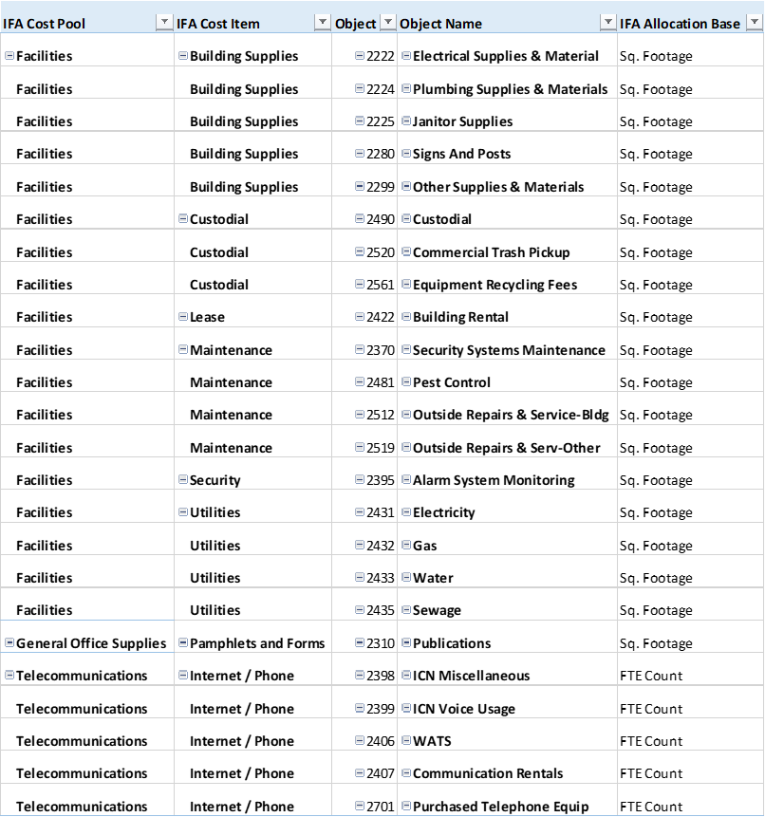
IFA Cost Pool, Cost Items, Allocation Base
Items to Consider for IFA:
Computer Equipment for participants / customers
Copy Paper
Equal Opportunity Officer*
Front Desk Personnel
Office Furniture
Office Supplies
Paper Shredding
Postage
Printers
Software / Hardware
Allocation Methods Available:
Customers Served
FTE
Telephone Ports
Square Footage

Slide 9
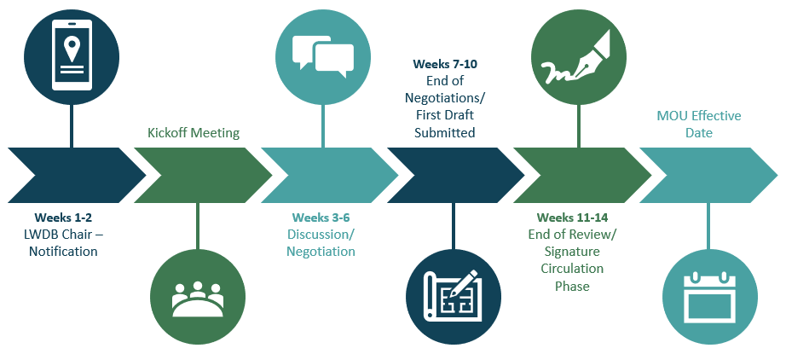
Sample Timeline
July 1, 2024

Slide 10
Office Hours
9:00AM-10:00AM
October 5, 2023: https://iowaworks.zoom.us/j/83167464883?pwd=NkpxUlEvUW5PaVFWc25rRnlsbmMxQT09
December 7, 2023: https://iowaworks.zoom.us/j/88973779087?pwd=R2RNOE5kajV3c3diRUs0ZndEdU1FQT09
February 1, 2024: https://iowaworks.zoom.us/j/81042918211?pwd=bVRUcG9sOFlaVnozN1p2REJHUEordz09
April 4, 2024: https://iowaworks.zoom.us/j/87245300937?pwd=VkhRaCtzb0JzRXZ0b2xYNHk2TXJCQT09
May 2, 2024: https://iowaworks.zoom.us/j/86397059673?pwd=TGdiY3grRHBCOGFKTmFxUkhZYUZ2QT09

Slide 11
Questions and Discussion

