Slide 1
Business Engagement: Collaboration with WIB and Industry Sector Boards
JRWA Project Directors Meeting
January 25, 2017

Slide 2
What is a Sector Approach?
A systems approach to workforce development, typically on behalf of low-income individuals, that:
Targets a specific industry or cluster of occupations
Develops workforce solutions tailored to an industry and region
Supports workers in improving their employment-related skills and ability to compete for higher quality jobs
Meets the needs of employers
Creates lasting change in the labor market system
Source: The ASPEN Institute http://sectorskillsacademy.org/Sector.html

Slide 3
What are Sector Strategies?
Promote systemic change that cultivates a win-win environment by restructuring:
Internal and external educational opportunities
Employment and business practices
Public policies
To achieve changes beneficial to:
Employers
Low-wage workers
Low-income job seekers
Source: The ASPEN Institute http://sectorskillsacademy.org/Sector.html

Slide 4
Workforce System
Sector Partnership Leadership Council
Federal Department of Labor: Workforce Investment and Opportunity Act (WIOA)
Future Ready Iowa
Iowa Workforce Development: State Plan
must coordinate and align workforce programs to provide coordinated, complementary, and consistent services to job seekers and employers.
Regional Workforce Development Board: Regional Plan
must coordinate and align workforce programs to provide coordinated, complementary, and consistent services to job seekers and employers.
Seamless System
Coordination among providers that supports and efficient and effective customer experience.
Industry Sector Board(s)
Identify workforce needs, develop and implement industry strategies to address regional workforce needs.
Career Pathways
Develop training pathways that connect a pipeline of educated and skilled workers to current and emerging industries leading to self-sufficient careers.
Advanced Manufacturing Industry Sector Board
Architecture, Construction and Engineering (ACE)
Financial Services, Insurance, Customer Service Industry Sector Board
Health Care Industry Sector Board
Information Technology Industry Sector Board
Transportation and Logistics Industry Sector Board
Notes:
The development of 6 Industry Sector Boards occurred over time.
Refer to the Sector Board Summary - handout

Slide 5
Value Add
1) Business Driven
Businesses inform:
2) Outreach and Recruitment
Businesses- inform candidates not selected for employment of training opportunities
3) Business Engagement in Training and CBO partnership to address student needs
4) Employment Preparation and Attainment
Career Services
Business Engagement
Mock Interviews
Job Fairs
Training pathways
Occupation demand/forecast
Skill needs
Community Based Organizations (CBO’s)- refer individuals who are stable and ready to pursue training
CBO’s
Job Shadows
Internships
Business tours
Address social service needs of students
Notes:
Judy
Business Driven- Inform skill needs and training needed
Outreach and Recruitment
Agreements between business and the College allow for Kirkwood to reference which businesses endorse training that is being marketed.
Exploring ways for businesses to inform applicants who are not offered employment, training that is being promoted by area businesses.
Existing workforce; employees within partnering companies.
Business Engagement in Training and CBO partnership to address student needs
Engage businesses in speaking with students in the classroom, providing tours, etc. This gives businesses to network with possible candidates for employment and vice versa.
CBO’s play a critical role in providing social services that are not the expertise of the Community College.
Employment Preparation and Attainment
Support students in accessing career services in preparation for completing training and seeking employment.
Coordinate events for students to interview with partnering businesses.

Slide 6
A Deeper Dive
Working within a regional workforce development system
Step by step on how to get Industry Sector Boards started
Examples of career pathway maps
Examples of workforce strategies pursued by boards
Examples of training pathways
Examples of employer engagement
Notes:
Workforce System
targeted approach to training and addressing workforce needs
Better utilization of tax payer dollars

Slide 7
Getting Started
Step 1: Invested in professional development
Invested in training
Conferences
Aspen Institute Sector Academy
Read national research to learn about the purpose and role of sector approaches
Surveying work done in the state and surrounding areas
Hired a consultant to facilitate the development of first Sector Board

Slide 8
Getting Started
Step 2: Determined sector priorities
Reviewed labor market data
Engaged Regional Workforce Board
Data analysis
Elevated priority occupation clusters
Prioritized sectors
Notes:
Largest workforce sector; largest percentage of workers employed in this industry
Kirkwood had already been meeting regularly with businesses within this sector.

Slide 9
Advanced Manufacturing Sector Board: How Did We Get Started?
Step 1: Met with partners (economic development groups, K-12, and workforce services) to discuss starting a Sector Board and gain buy in.
Step 2: Convened a small group of individuals interested in Sector Board work and discussed facilitation strategies with an external consultant.
Step 3: Planned first meeting agenda. Primary focus: Introductions and background on Sector Boards, member role, advantages, best practices, and level of commitment needed to continue.
Step 4: Worked with Kirkwood and Iowa WORKS WIA to determine list of employers to invite based on employment level, number of job openings, and past working relationships with economic development organizations, Iowa WORKS, and Kirkwood

Slide 10
Advanced Manufacturing Sector Board: How Did We Get Started?
Step 5: Invited Advanced Manufacturing employer members (about 35) from the community. Invitation sent from President of Kirkwood.
Step 6: First meeting, led by external consultant with Kirkwood facilitating. Gained commitment to continue and move forward from this first meeting.
Step 7: Next meetings focused on providing the board with regional labor marketing information about the industry cluster.
Step 8: Began the process of development of the Occupational Map at the same time leading discussions on short and long term goals the board would like to achieve.

Slide 11
Advanced Manufacturing Sector Board
Active Companies Represented
Highway Equipment Company Centro
TSF Structures Barnes Manufacturing
Newell Machinery Bentley Manufacturing
Clickstop Bazooka Farmstar
ACP ACH Foam
PMX Coles Quality Foods
Newell Machinery Midwest Metal Products
NIS
Frontier
Notes:
Companies represent machining, assembly, production, plastics and metal

Slide 12
Advanced Manufacturing Sector Board: How Did We Get Started?
Step 9: Goals were determined and Occupational map was completed
Step 10: More formal board structure with Chair, Vice-Chair and bylaws was established
Step 11: Continually engage additional members

Slide 13
Advanced Manufacturing Sector Board: Business Case
An Educated and Skilled Workforce
Business innovation is a strategic imperative
A highly skilled and educated workforce is one of the most critical elements for innovation success
Regional Skills Gap is widening, qualified applicant pools are shrinking

Slide 14
Advanced Manufacturing Sector Board: Goals at Start Up
Increase communication to all employers/partners regarding current activity involving industry, education and best practices (completed and ongoing)
2. Increase partnerships between employers, education, community- based organizations and workforce development to address skills gaps (completed and ongoing)
3. Develop and locate tools to better match people to manufacturing careers
Develop a unified marketing and outreach program to improve the visibility, perception, and understanding of manufacturing careers
(current goal)
Target Audiences:
Middle and High School Students
Available Workforce (underemployed, adult and unemployed)
5. Increase exposure to manufacturing through internships, tours, job shadows and faculty/instructor engagement (current goal)

Slide 15
Advanced Manufacturing Sector Board: New Goals
Serve as the advisory committee for the K-12 CTE Program Manufacturing Curriculum and Assessment and Kirkwood’s Advanced Manufacturing Program and Noncredit Manufacturing Certificate Programs (Completed and Ongoing)
2. Develop and map the career and education pathway for the Advanced Manufacturing Sector (Manufacturing Production Sub-Sector (Completed)
3. Align the Advanced Manufacturing career pathway map with existing certificate, diploma and degree programs (Completed)
4. Review current programs, identify gaps, seamless approaches, and determine needed technical standards, skills standards, and or program changes (On-going)

Slide 16
How did we go about adding additional Sector Boards
Organic process
Financial Services, Insurance, and Customer Services evolved from a Call Center Advisory Committee to an Industry Sector Board
Health Care- regional occupation demand
Information Technology – statewide growth and demand
Architecture, Construction and Engineering (ACE)- two faculty engaged and requested

Slide 17
Workforce Strategy Themes Across Sector Boards
Occupation Pathway Mapping
Occupation Awareness
Training Pathway Development
Employer Engagement

Slide 19
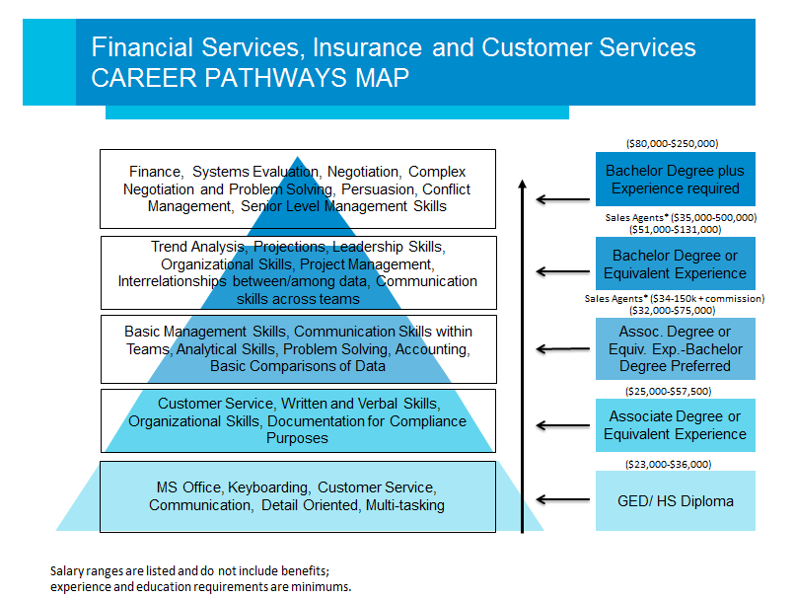

Slide 22
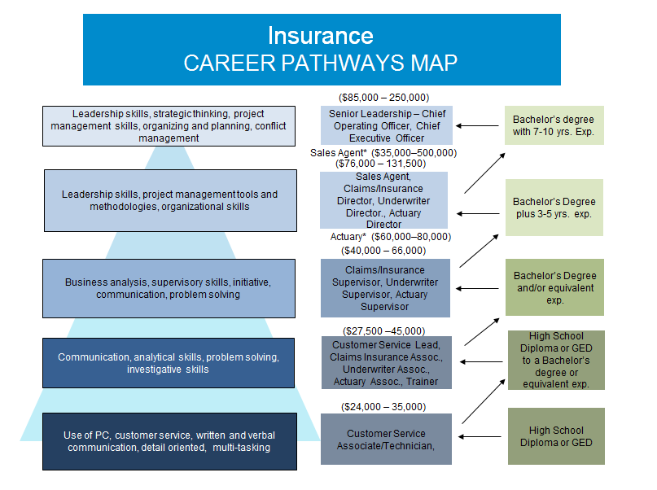

Slide 23
Health Care Occupation Outlook in Iowa between 2012-2022
Top 10 Occupations Expected to have the Largest Employment Growth include:
#2: Registered Nurses: 5,635
#8: Home Health Aides 3,415
Top 10 Fastest Growing Occupations include:
Occupational Therapy Assistants (4.4%)
Medical Sonographers (4.4%)
Physical Therapists Assistants (3.8%)
Personal Care Aides (3.7%)
Occupations with the Most Annual Openings includes:
Registered Nurses
Source: State of Iowa 2012-2022 Occupational Projections Summary

Slide 24
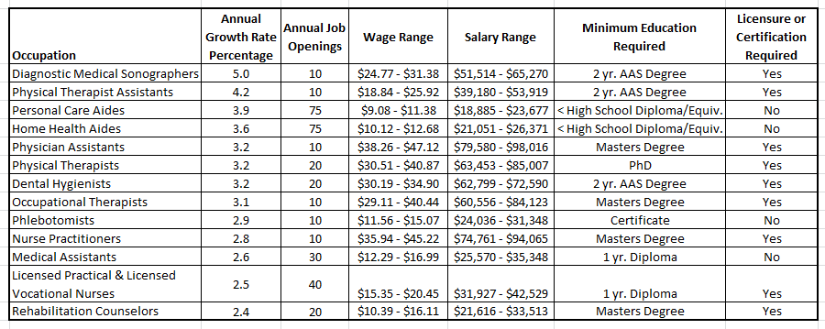
2012-2022 Projections Fastest Growing Health Care Occupations in Region 10
Source: Iowa Workforce Development (IWIN)
* Region includes Benton, Cedar, Iowa, Johnson, Jones, Linn and Washington Counties
** Wage and salary may vary based on location in the region and setting.

Slide 25
2012-2022 Projections Health Care Occupations with the Most Openings in Region 10
Source: Iowa Workforce Development (IWIN)
* Region includes Benton, Cedar, Iowa, Johnson, Jones, Linn and Washington Counties
** Wage and salary may vary based on location in the region and setting.

Slide 26
Health Care CAREER PATHWAYS MAP
Clinical Career Opportunities:
Greater occupation opportunities with increased education and training.
PhD/Masters
Bachelors Degree
2 yr. Associates Degree
1 yr. Diploma
Certificate
HS Diploma/ GED
Supervisor , Management, Administration
PhD/Masters
Non-Clinical Career Opportunities:
Substantial number of entry level positions.
A non-clinical occupation can serve as a gateway to expanded occupation opportunities in the industry.
Bachelors Degree
2 yr. Associates Degree
1 yr. Diploma
Certificate
HS Diploma/ GED
*Clinical: observation and treatment of actual patients
**Non-Clinical: work behind the scenes; may interact with patients, however do not provide medical care

Slide 27
Health Care Non-Clinical CAREER PATHWAYS MAP
Pastor, Health Care Administration
Masters / Doctorate
Health Information
Management, Health Care
Administration
Bachelor Degree
Billing Revenue Cycle Representative,
Clinical Informatics/ Information Technology,
Medical Coding Representative I/ II- Certified,
Medical Records Technician
2 year Associates Degree
Central Sterilization II, Cook
1 year Diploma
Field Staff Supervisor/ Care Manager,
Central Sterilization I, Health Information Management
Pharmacy Technician
Certificate
Delivery Technician/Courier, Dietary Aide(16 yrs. Old), Central Supply Technician, Cook Assistant, Environmental Aide), Floor Technician, Guest Relations Specialist , Homemaker, Home Medical Equipment Technician, Housekeeper and Laundry, Intake Specialist, Patient Transport, Registration, Secretary/Receptionist,
GED/ HS Diploma
Non-Clinical: work behind the scenes; may interact with patients, however do not provide medical care

Slide 28
Health Care Clinical CAREER PATHWAY MAP
Audiologist, Behavior Health Specialist- Clinical Social Worker, Counselor, Clinical Nurse Specialist (CNS), Nurse Practitioner, Occupational Therapist, Pharmacist, Physical Therapist, Physician Assistant, Speech Therapist, Nurse Educator
Masters / PhD
Dietician, Medical Technologist, Registered Nurse- BSN
Bachelor Degree
Certified Respiratory Therapy Assistant Compliance Auditor, Dental Technician, Dental Hygienist, Clinical Informatics/ Health Information Technician, Medical Lab Technician, Occupational Therapy Assistant, Paramedic, Physical Therapist Assistant, Radiology Technician, Registered Nurse, Respiratory Therapy Technicians, Scribe, Sonographer
2 year Associates Degree
Hemodialysis Technician, Licensed Practical Nurse,
Surgical Technologist, Dental Assistant,
Medical Assistant, Medical Coder, Medical Transcriptionist
1 year Diploma
Audiology Assistant/Technician, Certified Medication Aide, Certified Nurse Aids, Certified Pharmacy Technician, Emergency Medical Technicians, Optometry Assistant
Certificate
Rehabilitation Technician, Home Health Aid, Phlebotomist, Personal Care Aides, Assistive Technologies Practitioner
GED/ HS Diploma
*Clinical: observation and treatment of actual patients

Slide 29
.

Slide 30
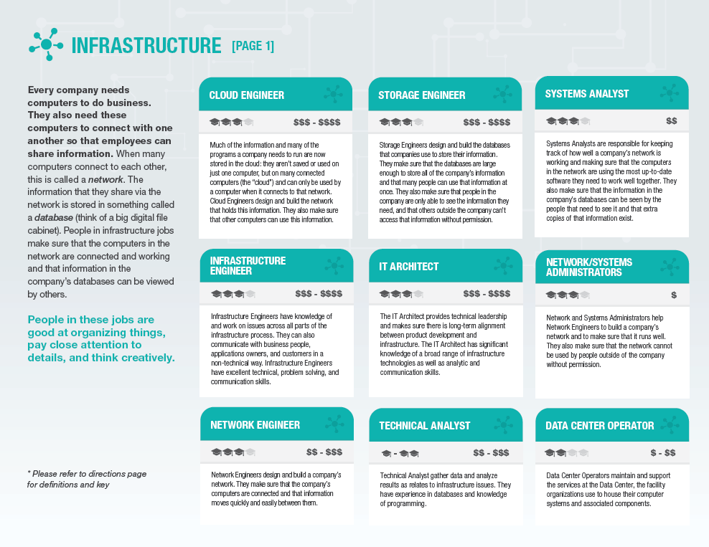

Slide 32
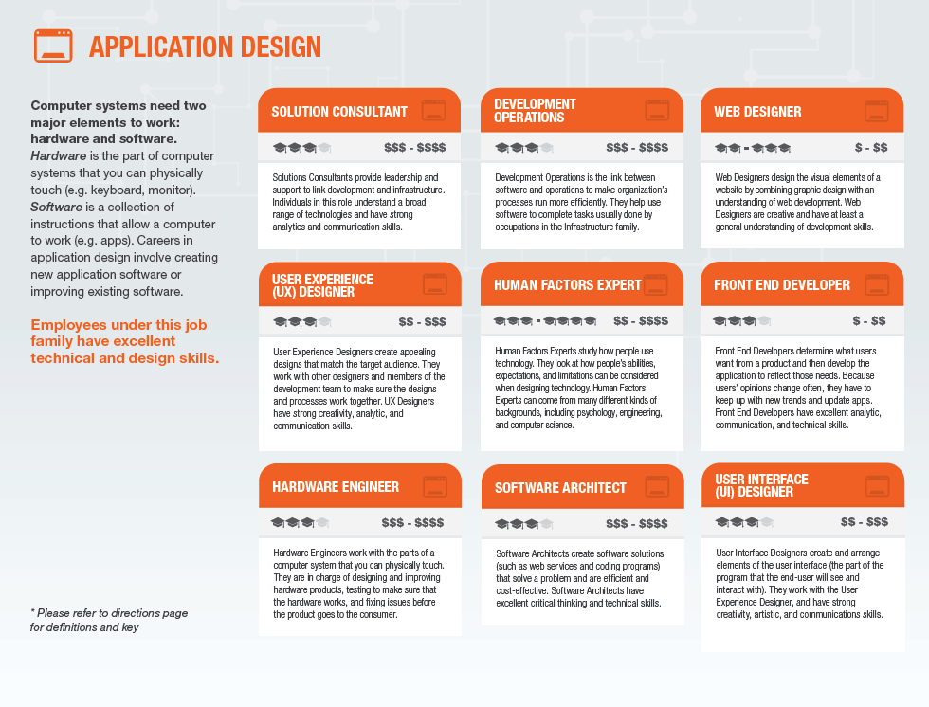

Slide 33
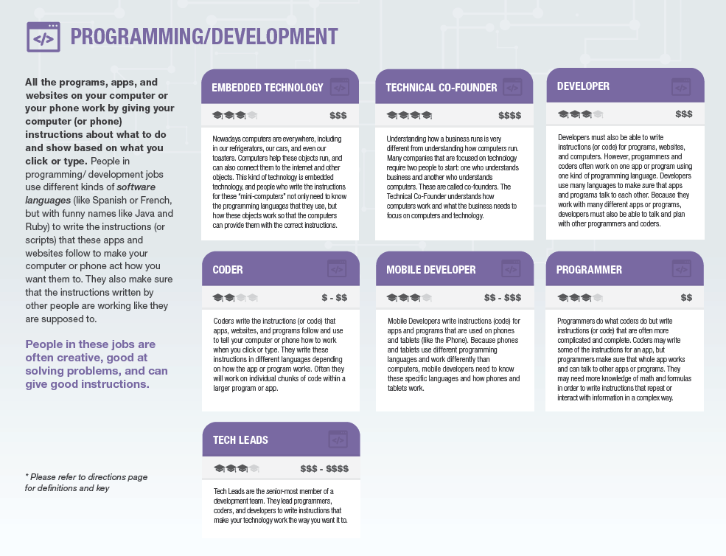

Slide 35
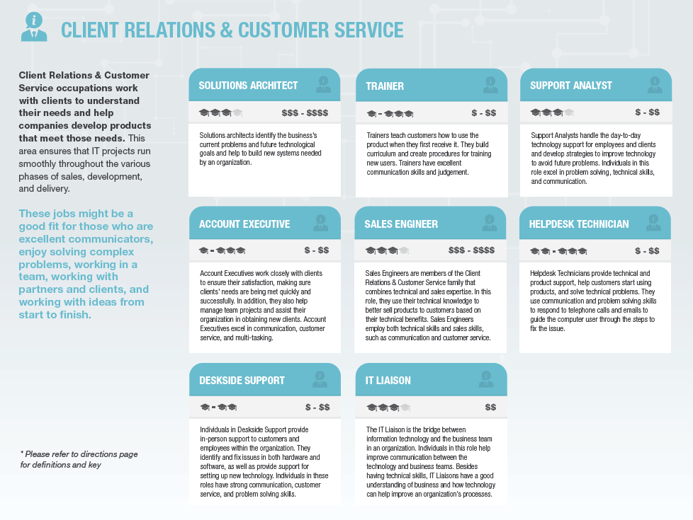

Slide 36
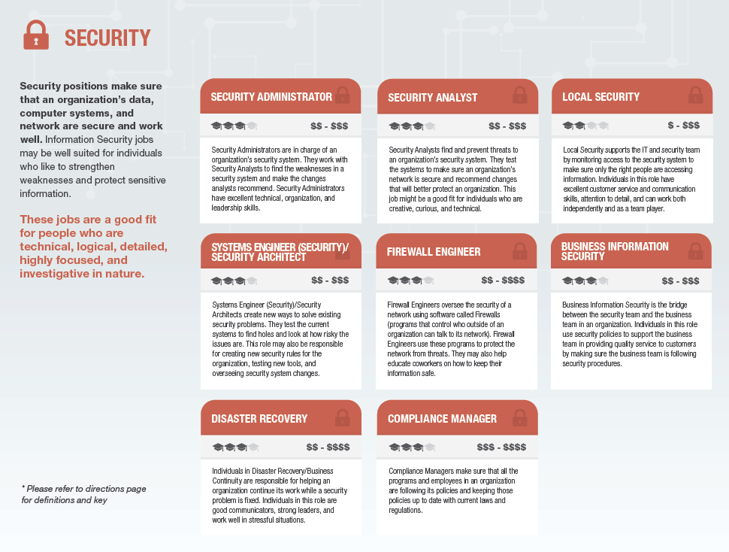

Slide 37
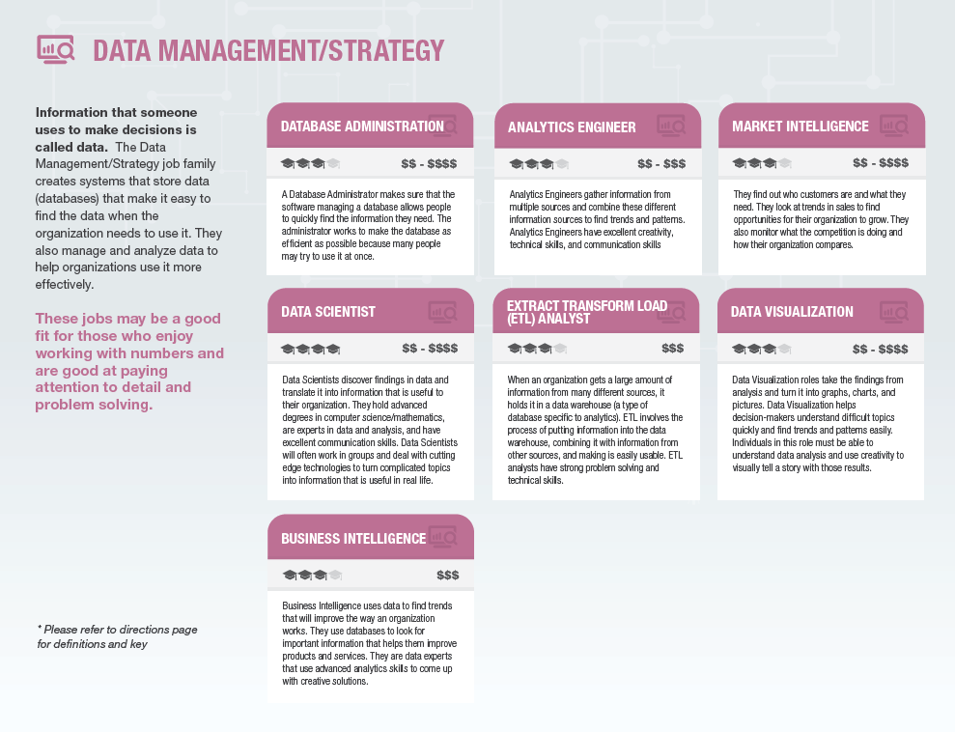

Slide 38
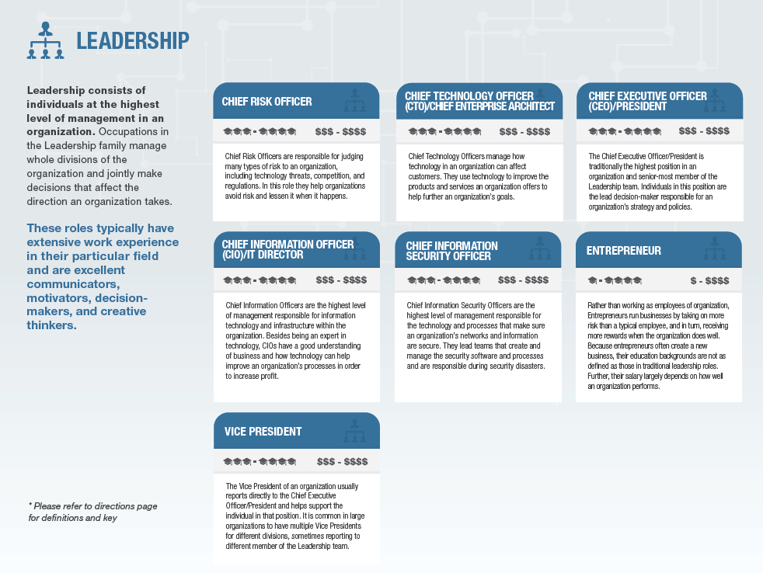

Slide 39
Occupation Awareness
Middle School Students
partner with workforce intermediaries on exposing students to careers
in the industry.
High School Students
partner with workforce intermediaries to engage students in
occupation experiences such as job shadows, internships, and on the job training
Unemployed and Underemployed
- Learning exchange events between One Stop staff and businesses.
- Co-hosted information session for Iowa WORKS customers on a career in CNC
Machining.
- Organized career fairs to fill short and long term labor shortages.
Other/All
Video Links:
Ad. Man.: https://youtu.be/-qMB0Day9sY
IT: https://drive.google.com/open?id=0B3Jww-lLrzdcdGpLRWg0SVNqSk0
Advancing the Futures Tour Events
All-Star Awards

Slide 40
Assess Edu. and Training Needs/ Training Pathway Development
Advanced Manufacturing
Customized Accelerated CNC Machining (9 weeks) and Welding training (16 weeks)
- Customized Leadership in Manufacturing training
Financial Services
Continuous refinement of Customer Service
Professional Certificate Training; transformed into
a work-based learning format.
- Companion web-based module

Slide 41
Advanced Manufacturing
Basic Education
KPACE Connections
Introduction to Manufacturing (Non-Credit)
Non-Credit Articulated Certificate
Welding with AWS Certification
Credit Programs
Welding
Industrial maintenance
Industry Sector Board Requested
Accelerated Welding
Accelerated CNC Machining

Slide 42
Health Care
Basic Education
KPACE Connections
Introduction to Health Care Careers
CPR/First Aid
Non-Credit Articulated Certificate
Certified Nursing Assistant
Medical Office Professional
Credit Programs
Nursing
Medical Assistant
Administrative Assistant

Slide 43
Customer Service/IT
Basic Education
KPACE Connections
Introduction to Customer Service
Non-Credit Articulated Certificate
Customer Service Professional
_____________
9 Credit Hours
_____________
Credit Students Co-enrolled
Credit Programs
Administrative Assistant
Computer Support Specialist

Slide 44
Employer Engagement
Sector Board Guides Curriculum Decisions
Business Partner Agreements
Industry partner tours/classroom visits
Student performance data shared with business partners
Student interviews with partners
Simulated Work Environment
Attendance requirements/tracking
Professional dress
Biweekly evaluations

Slide 45
Kim Becicka
Vice President, Continuing Education and Training Services
319-398-5525
Kim.Becicka@kirkwood.edu
Judy Stoffel
Student Access Program Developer
319-398-5503
Judy.Stoffel@kirkwood.edu

